Slide 1
Test Automation Using Selenium

Slide 2
Test Automation
Test automation is the use of software
    To set test preconditions.
    To control the execution of tests.
    To compare the actual outcomes to predicted outcomes.
    To report the Execution Status.
Commonly, test automation involves automating a manual process already in place that uses a formalized testing process.

Slide 3
Why and When To Automate?
Frequent regression testing
Repeated test case Execution is required
User Acceptance Tests
Faster Feedback to the developers
Reduce the Human Effort
Test same application on multiple environments

Slide 4
Selenium
Selenium is a free (open-source) automated testing framework used to validate web applications across different browsers and platforms. Selenium provides a rich set of testing functions specifically geared to the needs of testing of a web application.
Supports Cross Browser Testing. The Selenium tests can be run on multiple browsers.
Allows scripting in several languages like Java, C#, PHP and Python.
Assertion statements provide an efficient way of comparing expected and actual results.

Slide 5
Selenium Web Driver
It interrogates and manipulates the HTML.
Contains domain-specific language (Selenese).
There are multiple ways to find out the HTML element and those are called Web Element in selenium like Id, class, CSS, Xpath few locators which will be used commenly.

Slide 6
Finding elements by
ID: – By.id(“cheese”);
Class: – By.class(“cheese”);
Name: – By.name(“cheese”);
Tag Name: – By.tagName(“cheese”);
LinkText/partial link text: – By.linkText(“cheese”);
CSS: – By.cssSelector(“#food span.dairy.aged”);
XPath: – By.xpath(“//input”);

Slide 7
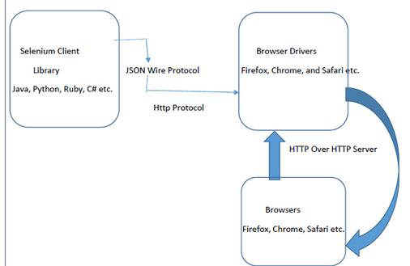
Structure of Web Driver

Slide 8
Setting Up an Eclipse Project for Selenium Automation
Eclipse is an open source community whose projects are focused on building an extensible development platform for building Java applications and frameworks. Eclipse is one of the best Java IDE and as a matter of face Eclipse is much more than a Java IDE.
We can configure a selenium project in eclipse and even run the scripts from eclipse.
Eclipse also allows us to write reusable code for efficient test automation.

Slide 9
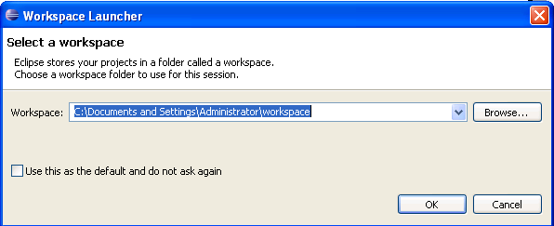
Installing Eclipse
Download the “Eclipse IDE for Java Developers” from the http://www.eclipse.org/downloads/ page.
Unzip the downloaded zip file from the above site into a directory.
Once the unzipping is over open the folder and double click on the icon and it will open a dialog box as shown below.

Slide 10
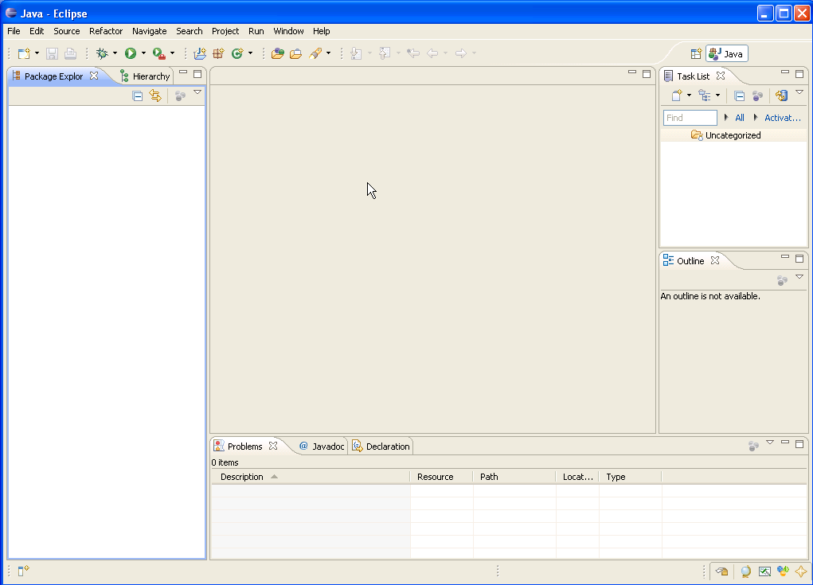
Eclipse IDE
Scrip View
Package
Explorer
console

Slide 11
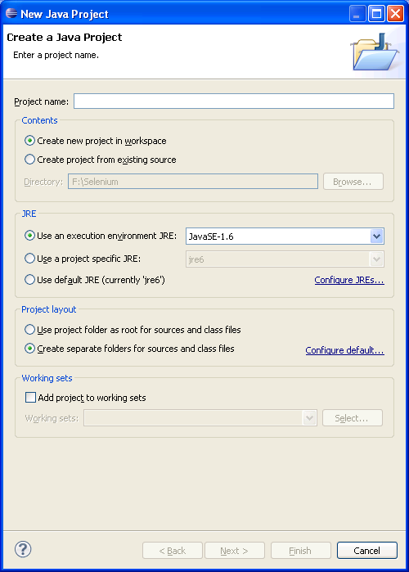
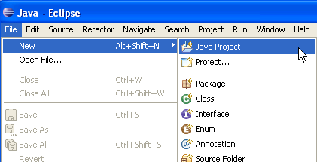
Create a Project In eclipse
File → New → Java Project
Specify the project name and click finish

Slide 12
MAVEN
Maven is a build tool and it performs a task just like Ant which is again a different build Tool. It is a software project management tool that provides a new concept of project object model (POM).
Maven Local Repository
This is the place where Maven stores all the project jars files or libraries or dependencies. By default the folder name is ‘.m2‘
Maven Central Repository
Maven central repository is the default location ‘http://mvnrepository.com/‘ for Maven to download all the project dependency libraries. For any library required in the project, Maven first looks into the .m2 folder of Local Repository, if it does not find the required library then it looks in Central Repository and downloads the library into the local repository.

Slide 13
Dependency Keyword
Dependencies are the libraries, which are required by the project. For example Log4j jars, Apache Poi jars, Selenium Jars, etc. Dependencies are mentioned in the Maven pom.xml like this:
  <dependency>
  <groupId>org.seleniumhq.selenium</groupId>
  <artifactId>selenium-java</artifactId>
  <version>2.43.1</version>
  </dependency>
  .

Slide 14
Install Maven
Download the “Maven” from the http://maven.apache.org/download.cgi.
Unzip the downloaded zip file from the above site into a directory.
Once the unzipping is over copy the path of folder and setting in Environment Variables with /bin in end of the path of folder.
After that, run in cmd with mvn command.

Slide 15
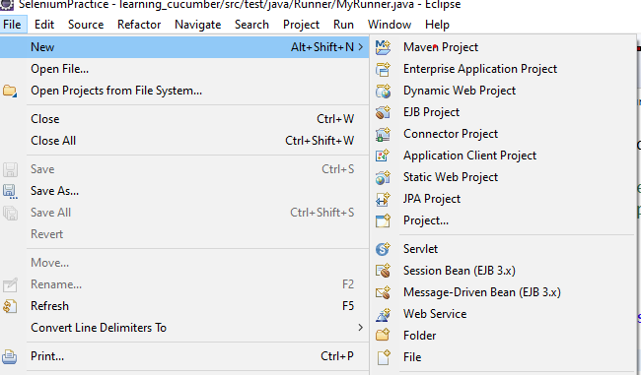
Create a Project in Maven

Slide 16
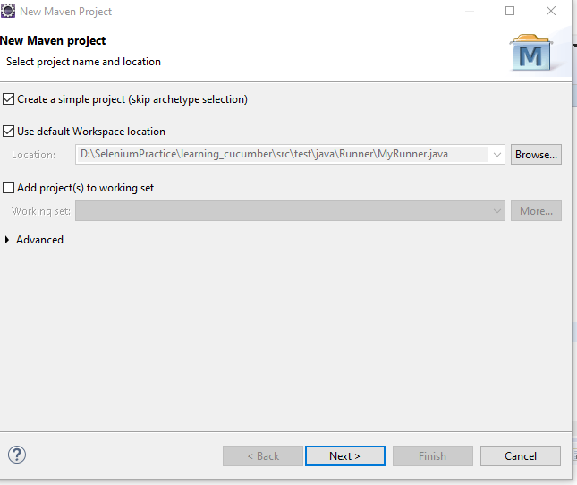

Slide 17
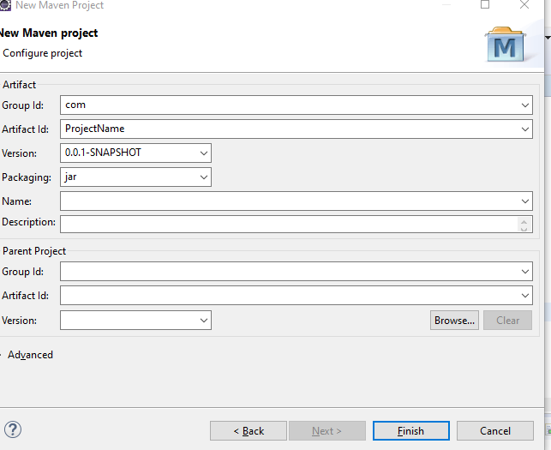

Slide 18
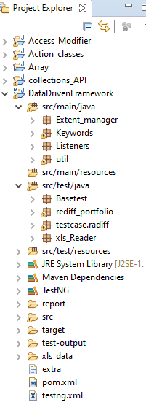
Folder Structure

Slide 19
Presentation 2

Slide 20
Frameworks and Third party Libraries
Data-driven Testing Framework.
-TestNG
Behavior Driven Development Testing Framework.
-Cucumber
POM(Page Object Model)- This is a design pattern can be used with any kind of framework like keyword-driven, Data-driven, hybrid framework, BDD etc.
Extent Report
Apache POI
AutoIT

